Slide 1
Software project management
Concerned with activities involved in ensuring
that software is delivered on time and on
schedule and in accordance with the
requirements of the organisations developing
and procuring the software.
Project management is needed because software development is always subject to budget and schedule constraints that are set by the organisation developing the software.
1

Slide 2
Software management distinctions
The product is intangible.
The product is uniquely flexible.
Software engineering is not recognized as an
engineering discipline with the same status as
mechanical, electrical engineering, etc.
The software development process is not
standardised.
Many software projects are 'one-off' projects.

Slide 3
Management activities
Proposal writing.
Project planning and scheduling.
Project costing.
Project monitoring and reviews.
Personnel selection and evaluation.
Report writing and presentations.

Slide 4
Management commonalities
These activities are not peculiar to software
management.
Many techniques of engineering project
management are equally applicable to software project management.
Technically complex engineering systems tend
to suffer from the same problems as software
systems tend to suffer.

Slide 5
Project staffing
May not be possible to appoint the ideal people to work on a project
  Project budget may not allow for the use of highly-paid staff;
  Staff with the appropriate experience may not be available;
  An organisation may wish to develop employee skills on a software project.
Managers have to work within these constraints especially when there are in shortage of trained staffs.

Slide 6
Project planning
Probably the most time-consuming project management activity.
Continuous activity from initial concept through
to system delivery. Plans must be regularly revised as new information becomes available.
Various different types of plan may be developed to support the main software project plan that is concerned with schedule and budget.

Slide 7
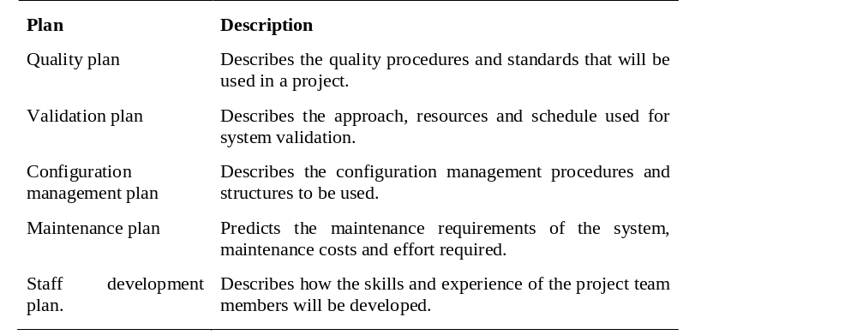
Types of project plan

Slide 8
Project planning process
Establish the project constraints
Make initial assessments of the project parameters
Define project milestones and deliverables
while project has not been completed or cancelled loop
Draw up project schedule
Initiate activities according to schedule
Wait ( for a while )
Review project progress
Revise estimates of project parameters
Update the project schedule
Re-negotiate project constraints and deliverables
if ( problems arise ) then
Initiate technical review and possible revision
end if
end loop

Slide 9
The project plan
The project plan sets out:
  The resources available to the project;
  The work breakdown structure;
  A schedule for the project.

Slide 10
Project plan structure
Introduction.
Project organisation.
Risk analysis.
Hardware and software resource requirements.
Work breakdown structure.
Project schedule.
Monitoring and reporting mechanisms.

Slide 11
Activity organization
Activities in a project should be organised to produce tangible outputs for management to judge progress.
Milestones are the end-point of a process activity.
Deliverables are project results delivered to customers.
The waterfall process model allows for the straightforward definition of progress milestones.

Slide 12
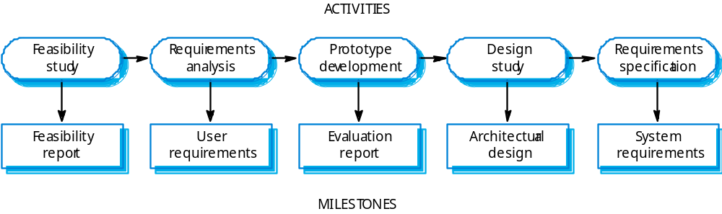
Milestones in the Requirement Elicitation process

Slide 13
Project scheduling
Split project into tasks and estimate time and resources required to complete each task.
Organize tasks concurrently to make optimal
use of workforce.
Minimize task dependencies to avoid delays
caused by one task waiting for another to complete.
Dependent on project managers intuition and experience.

Slide 14
Scheduling problems
Estimating the difficulty of problems and hence the cost of developing a solution is hard.
Productivity is not proportional to the number of people working on a task.
Adding people to a late project makes it later because of communication overheads.
The unexpected always happens. Always allow contingency in planning.

Slide 15
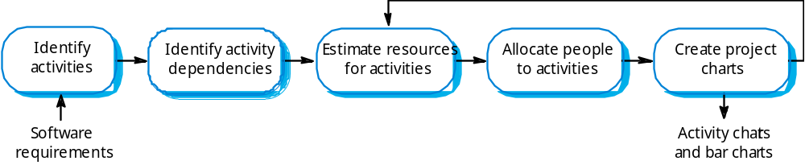
The project scheduling process

Slide 16
Bar charts and activity networks
Graphical notations used to illustrate the project schedule.
Show project breakdown into tasks. Tasks should not be too small. They should take about a week or two weeks.
Activity charts show task dependencies and the critical path.
Bar charts show schedule against calendar time.

Slide 17
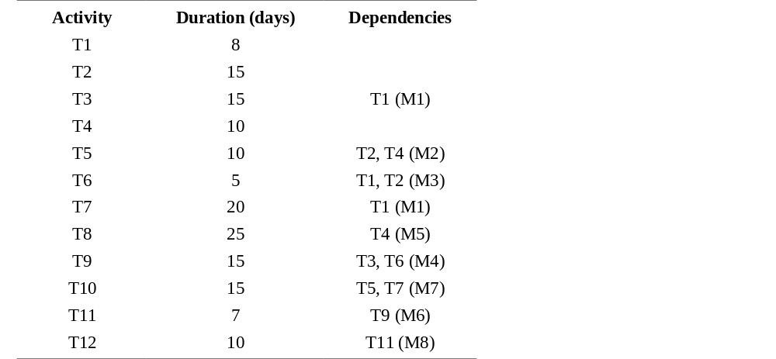
Task durations and dependencies

Slide 18
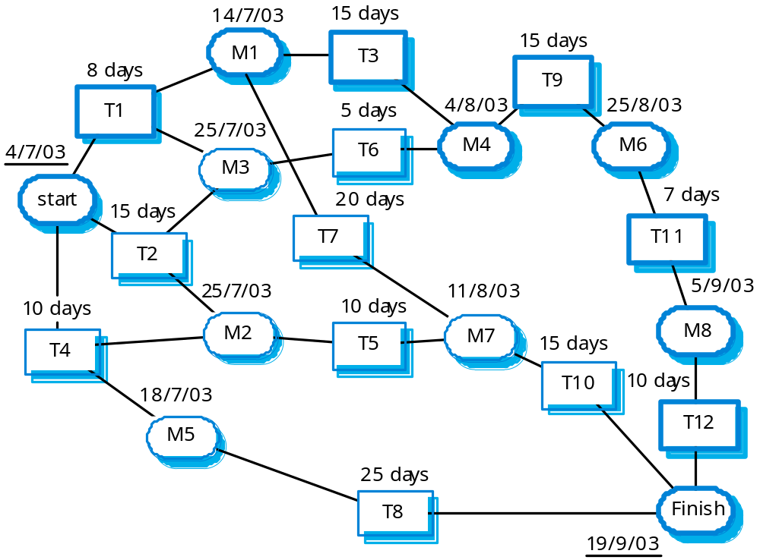
Activity network

Slide 19
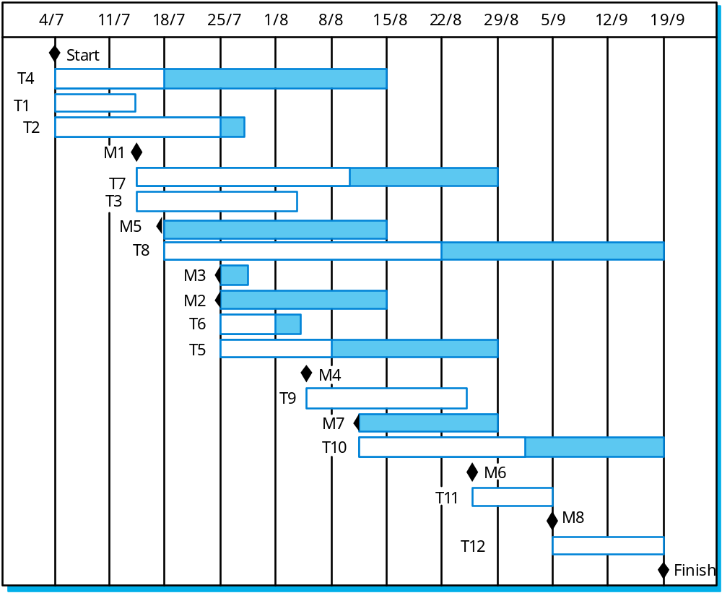
Activity timeline

Slide 20
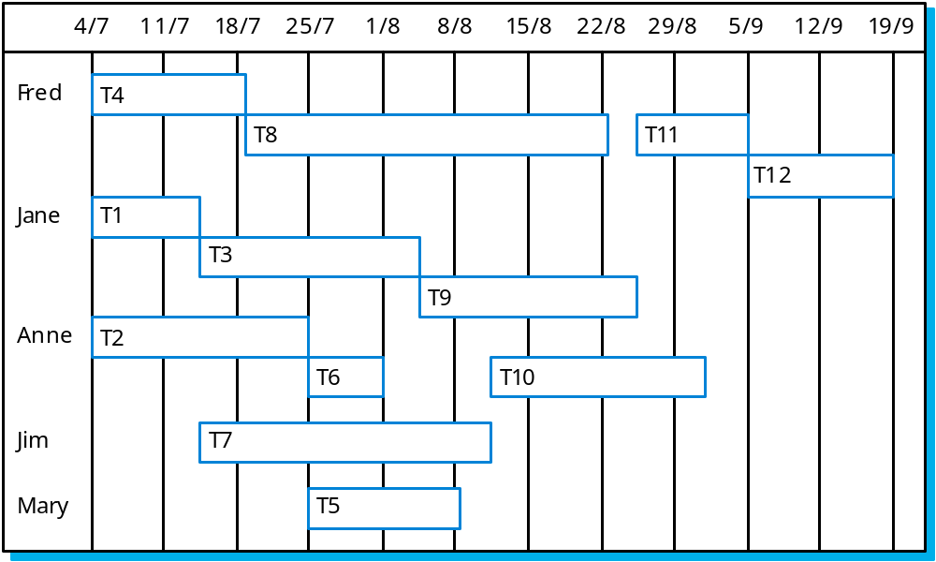
Staff allocation

